Slide 1

ORDER OF BATTLE
NOTE: This document and structure is a simplification and a compromise between real world organization and DCS limitation, while respecting that this is a hobby and not anyones job.

Slide 2
References
https://www.globalsecurity.org/military/library/policy/army/fm/3-90/ch2.htm

Slide 3
Content
EXPLANATION
Ground Forces
Headquarters
Armor Division
Air Defense Division
Artillery Battalion
Armor Brigade
Logistics Battalion
Named units
IV. Corps
Air Defence Forces (Airforce)
Air Defence Forces
3

Slide 4
Explanation: Symbols
IV CORPS
Rank of commanding officer (generals)
Name of unit
Armor Platoon
3x MBT
Types of vehicles in unit
Artillery Battery
Dashed line indicate that this unit is supporting , and is not organic to the unit.
Armor Platoon
Armor Platoon
Armor Platoon
3x MBT
Indicates similar units
(In this example 3 Armor platoons)
3x MBT
3x MBT
Maneuver units:
Armor, Mechanized and Motorized
Brigade
Brigade is the normal fighting unit (contains air defence, manueuver unit, logistics and artillery)
Division:
Offensive or defensive, this is the normal unit size for a sector
Corps:
A full front, contains additional Corps resources and a headquarter.
Back to content
Back to Corps

Slide 5
Explanation #2
Ground Forces
Ground forces are the combat manuever forces. This includes air defense forces assigned to the ground forces in direct support to protect the combat maneuver forces
Main maneuver ground forces are divided into:
Motorized: Wheeled infantry (APC)
Mechanized: Tracked Infantry Fighting Vehicles
Armor: Main Battle Tanks
These three are the main fighting force of any enemy unit. They are supported by Artillery, Air Defenses, Logistics, Recon
Air Defence Forces
Air Defence forces are Air Defences controlled by the Air Force
Back to content
Back to Corps

Slide 6







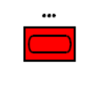
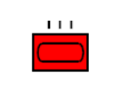





Symbols (Type and size)
UNIT TYPES
(Combatflite + briefings)
Infantry
Motorized infantry: Wheeled Armored Personell Carriers (APC)
Armor: Main Battle Tanks
Mechanized Infantry: Tracked Infantry Fighting Vehicles (IFV)
Artillery: Mortars
Mechanized Artillery: Tracked artillery
UNIT SIZES
(Combatflite + briefings)
Platoon
Regiment
Brigade
Company
Division
Battalion
Corps
Back to content
Back to Corps

Slide 7
Explanation : Example
FLOT
Armor Battalion
Armor Battalion
Armor Brigade
Armor Battalion
Armor Battalion
Armor Battalion
Armor Brigade
Armored Division
Armor Battalion
Armor Battalion
Armor Battalion
Armor Brigade
Armor Battalion
Armored Division Area of Operations
CORPS
Mechanized Battalion
Mechanized Division Area of Operations
Mechanized Battalion
Mechanized Brigade
Mechanized Battalion
Mechanized Battalion
Mechanized Battalion
Mechanized Brigade
Mechanized Division
Back to content
Back to Corps

Slide 8
Same example, with military symbols
FLOT
Back to content
Back to Corps

Slide 9
Explanation : Hierarchy
CORPS
Special Operations Regiment
Recon Regiment
Air Defence Division
Airborne Brigade
Rocket Artillery Brigade
Motorized Division
Armored Division
Mechanized Division
Missile Brigade
C2 Battalion
Air Defence Regiment
Armor Brigade
Logistics Battalion
Rocket Artillery BN
Armor Brigade
Armor Brigade
Air Defence BN
Armor Battalion
Artillery BN
Armor Battalion
Armor Battalion
Under the Corps, the Motorized, Armored and Mechanized Divisions have their own structure. In this example, the Armored Division is shown.
Below Armor Division is the Armor Brigade, also shown.
Back to content
Back to Corps

Slide 10
Explanation
Platoon
3x Fighting veichles ( MBT, IFV, APC)
Company/ Battery
3x Platoons
Battalion
2-5 Companies (3 ”line” companies + support/HQ)
Brigade / Regiment
3-5 Battalions (3 ”line” Battalions + support/HQ)
Division
3 Line Brigades + Regiments/Battalions for support
Corps
3 Line Divisions + Brigades, Regiments and Battalions in support
NOTE: ”line” refer to main combat unit such as armor, mechanized or motorzed infantry.
These are the main fighting force
Back to content
Back to Corps

Slide 11
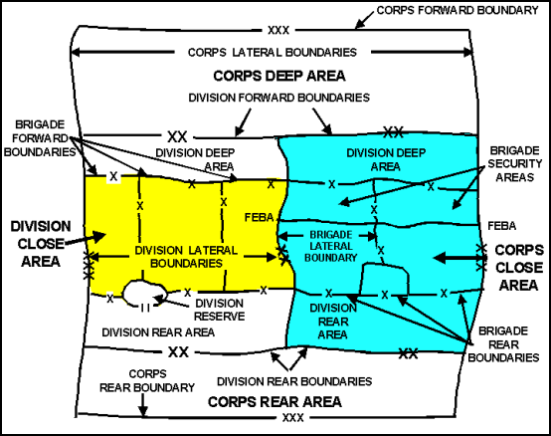
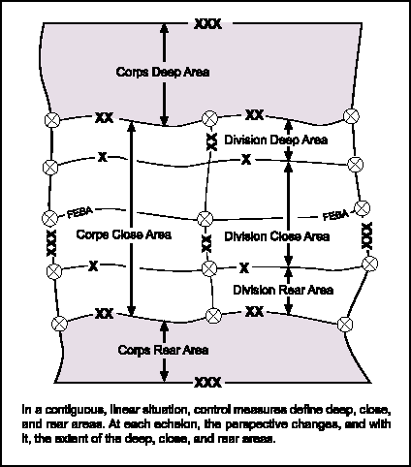
Explanation: Distances
Air Assault Brigade
Armor Battalion
Armor Brigade
Armored Division
CORPS
300-0km
0-10km
10-25km
20-50km
40-100km
Doctrinal distance from FLOT
NOTE: Air Assault Brigade jumping in behind enemy lines
Back to content
Back to Corps

Slide 12
Indicators
Here are indicators that can be used to identify activity that the enemy is doing:
BM-21 launch or movement into firing positions.
Preparing offensive / Attack
RW activity deep into enemy territory
Insertion of Long Range Recon
FW (transport) activity deep into enemy territory
Airborne Assault ( Many FW transports)
Long range Recon ( If only a single AC is in use, or flying tactical, low level)
Artillery at a certain point (point target)
Trying to kill the target
Artillery at an area
Suppression, to cover for movement / attack
Fill out many more…..
Artillery units in firing position (spread out, IAW a template)
General convoy movement
Upcoming action (offensive), in a certian amount of time
Back to content
Back to Corps

Slide 13
GROUND FORCES
This section includes information about the combat maneuver forces
This section contain generic information about unit size and organization
Back to content
Back to Corps

Slide 14
Corps
CORPS
Armored Division
Motorized Division
Mechanized Division
SA-6 Battalion
SSM Missile Regiment
Rocket Artillery Brigade
SA-6
SCUD
MLRS
Special Operations Regiment
Airborne Brigade
Reconissance Regiment
Helicopter Regiment
Logistical Regiment
NOTE: Click on symbol for link
Back to content
Back to Corps

Slide 15
Headquarters
The following section contains information about the various headquarters.
There are 2 variants of each headquarter level (echelon)
Defensive
Static headquarter at own territory. At their own / homebases.
C2 Bunkers.
Offensive
Mobile headquarters that can move with the force as the offensive move forward.
Vehicles and tents
Back to content
Back to Corps

Slide 16
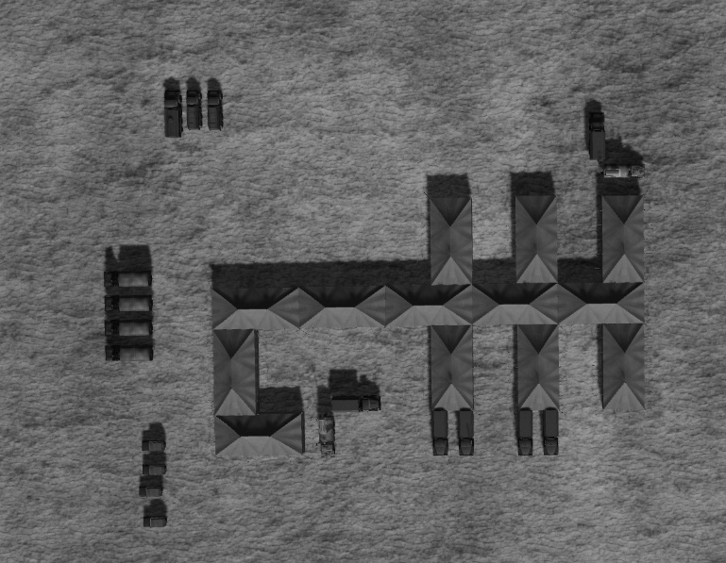
Corps HQ
Fuel for generators
Generator vehicles
CP SKP 11 ATC Mobile Command Post
CP Ural 375 PBU
Supply trucks
13 tents
VIP Transport
CP SKP 11 ATC Mobile Command Post
CP Ural 375 PBU
Corps HQ is in rear area and are protectected by a SA6 Battalion.
All Corps Headquarters will have the same layout on the tents. Amount of vehicles may vary but will as a minium contain what is shown on this picture.
Back to content
Back to Corps

Slide 17
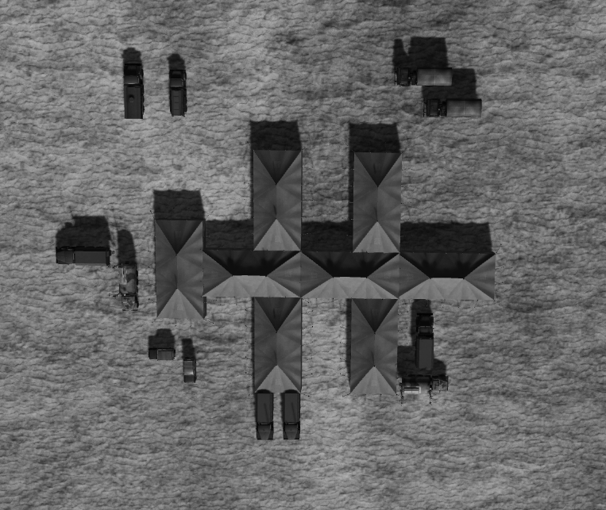
Divison HQ
All Division Headquarters will have the same layout on the tents
Back to content
Back to Corps

Slide 18
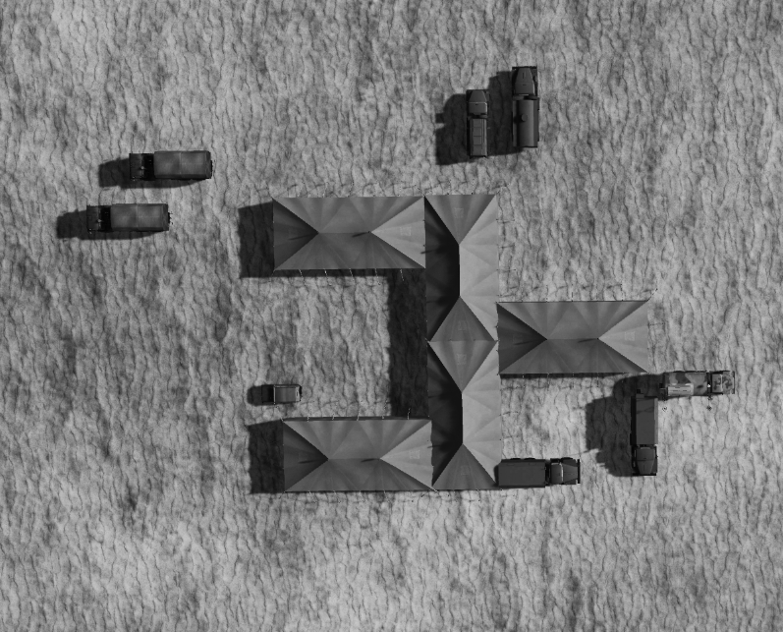
Brigade HQ
All Brigade Headquarters will have the same layout on the tents
Back to content
Back to Corps

Slide 19
ARMOR Division
Armor Div
Armor Brigade
Logistics Battalion
FARP
Supply points
Armor Brigade
Armor Brigade
Rocket Artillery BN
MLRS
(BM-21)
Air Defence Regiment
Back to content
Back to Corps

Slide 20
ARMOR Brigade
Armor Brigade
Armor BN
Artillery BN
Armor BN
Armor BN
Air Defence BN
Back to content
Back to Corps

Slide 21
Armor BN
Armor BN
Armor Company
Logistics Company
Artillery Battery
Armor Company
From Arty BN at Armor Brigade level
Armor Company
Air Defence Battery
From Air Defence Brigade at Armor Brigade level
Armor Platoon
Fuel Platoon
Armor Platoon
Armor Platoon
3x MBT
3x Fuel trucks
3x MBT
3x MBT
Ammo Platoon
3x Supply trucks
Back to content
Back to Corps

Slide 22
Mechanized Division
Mechanized Div
Mechanized Brigade
FARP
Supply points
Logistics Battalion
Mechanized Brigade
MLRS
(BM-21)
Rocket Artillery BN
Mechanized Brigade
Air Defence Regiment
Vehicles
Tents
C2 Battalion
Back to content
Back to Corps

Slide 23
Motorized Division
Motorized Div
Motorized Brigade
FARP
Supply points
Logistics Battalion
Motorized Brigade
MLRS
(BM-21)
Rocket Artillery BN
Motorized Brigade
Air Defence Regiment
Vehicles
Tents
C2 Battalion
Back to content
Back to Corps

Slide 24
Artillery Battalion
Artillery BN
Artillery Battery
Logistics Company
Artillery Battery
Artillery Battery
Artillery Section
Ammo Platoon
Artillery Section
Ammo Platoon
Ammo Platoon
3x Arty
3x Supply trucks
3x Arty
3x Supply trucks
3x Supply trucks
Back to content
Back to Corps

Slide 25
SSM Missile Regiment
SSM Missile Regiment
SSM Missile BN
SSM Missile BN
SSM Missile Battery
Logistical Company
SSM Missile Battery
2x TEL (launcher vehicles) per battery
Back to content
Back to Corps

Slide 26
Rocket Artillery Regiment
Rocket Artillery Regiment
Back to content
Back to Corps

Slide 27
Air Defence Regiment
Air Defence Regiment
Air Defence Battalion
SA-8 BN
SA-15 BN
Air Defence Battalion
Air Defence Battalion
4x Launchers
4x Launchers
+ CP Sborka
SA-11 BN
Back to content
Back to Corps

Slide 28
Air Defence Battalion
Air Defence Battalion
Air Defence Battery
Air Defence Battery
Air Defence Battery
Air Defence Battalion supportgs Maneuver Regiment
1x Air Defence Battery supporting a maneuver BN
Back to content
Back to Corps

Slide 29
Air Defence Battery
Air Defence Battery
Air Defence Platoon
Air Defence Platoon
Air Defence Platoon comes in 4 Different variants:
#1: 1x ZSU23/4 + SA-9 (Motorized)
#2: 1x ZSU23/4 + SA-13 (Mechanized)
#3: 1x ZSU23/4 + SA-8 (Armor)
#4: 1x SA-19+ SA-9
#5: 1x SA-19 + SA-13
#6: 1x SA-19 + SA-8
Back to content
Back to Corps

Slide 30
Helicopter Regiment
Helicopter Regiment
Attack Helicopter Squadron
Transport Helicopter Squadron
Back to content
Back to Corps

Slide 31
Logistical Regiment
Logistics Regiment
FARP BN
Logistical BN
2x FARPs
Large supply point in the rear. Transfer to frontline Divisions
Ammo
Fuel
Food
Specific vehicles: (same throughout all echelons)
Ammo:
Fuel:
Food:
Back to content
Back to Corps

Slide 32
Logistics Battalion
Logistics BN
Fuel Company
Supply Company
Ammo Company
Fuel Platoon
Supply Platoon
Ammo Platoon
3x Fuel trucks
3x Supply trucks
3xSupply trucks
Fuel Platoon
Supply Platoon
Ammo Platoon
3x Fuel trucks
3x Supply trucks
3x Supply trucks
Back to content
Back to Corps

Slide 33
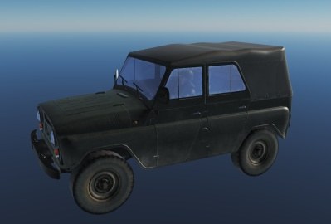
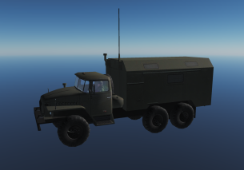
Recon Regiment
Reconissance Regiment
Reconissance Battalion
Long Range Recon Battalion
Special Recon Battalion
Reconissance Battalion
Reconissance Battalion
UAZ-469
CP URAL-375 PBU
1 Recon Battalion per Division, 1 Company per Brigade (used to recon the Brigades main axis of advance)
Long Range Recon:
Long range Recon uses RW, plane (parachute) or infiltrates by foot, deep behind enemy lines.
Primary task to locate logistics, Artillery and C2 of enemy forces or to prepare LZ for the Airborne Brigade.
Special Recon:
Uses Electronic warfare, both for jamming, direction finding, and collecting intelligence on enemy forces.
NOTE: Recon units due to its nature of collecting intelligence operates close to the FLOT, or on the enemy side of the FLOT.
Back to content
Back to Corps

Slide 34
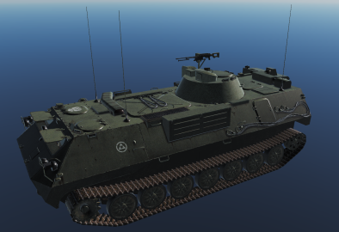
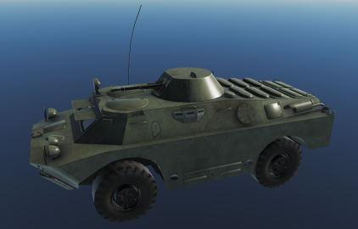
Recon BN
Reconissance Battalion
Recon
Company
Recon
Company
Recon
Company
Recon
Company
Wheeled
Recon Platoon
Recon Platoon
Recon Platoon
Recon Platoon
Recon Platoon
Recon Platoon
Recon Platoon
Recon Platoon
Recon Platoon
NOTE: Recon Company is either tracked or wheeled
In each platoon there are 2 vehicles
Recon units work together in pairs.
ARV MTLB-U BOMAN
ARV BRDM-2
Back to content
Back to Corps

Slide 35
Special Recon BN
Special Recon Battalion
Company
CP URAL-375 PBU
Company
Company
NOTE: Special Recon BN only operate in company sized in order to use Electronic Warfare (EW) in a proper way.
Each Company have 6 CP URAL 375 PBU (vehicle identified by the antenna used for EW and HQ UNIT
The veichles always operates as pairs. So if you see 2 CP URAL-375 PBU it is likely part of the Special Recon BN (unless they are located in one of the HQ, then it belongs to the C2 of the HQ).
Special Recon BN can be used either in support of the frontline combat forces (collecting intelligence, jamming, direction finding).
Companies may also be assigned certain areas in the rear where they are doing force protection, for example by jamming various frequencies.
Back to content
Back to Corps

Slide 36
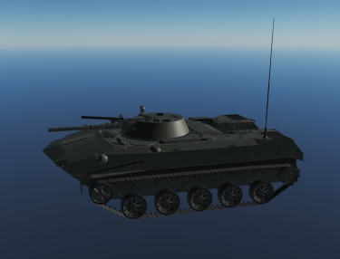
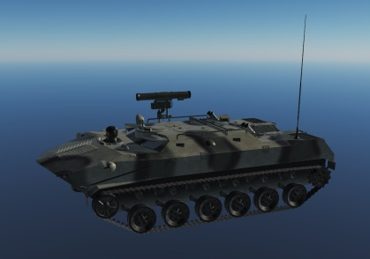
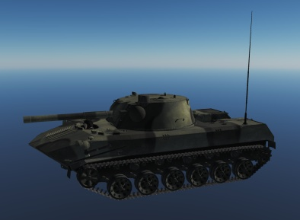
Air Assault Brigade
Air Assault Brigade
Air Assault BN
Air Assault Artillery BN
Air Assault BN
Air Assault BN
Inserted via IL-76MD
One IL-76 can carry 3 BMD (1 Airborne Platoon)
IFV BMD-1
ARV BTR-RD
SPH 2S9 NONA
Back to content
Back to Corps

Slide 37
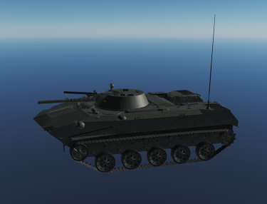
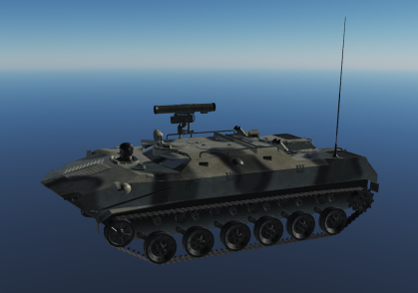
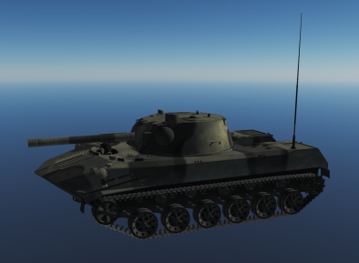
Air Assault Battalion
Air Assault Battalion
Air Assault Company
Air Assault Anti-tank Company
Air Assault Artillery Company
Air Assault Company
Air Assault Company
IFV BMD-1
ARV BTR-RD
SPH 2S9 NONA
IFV BMD-1
9 vehicles
6 vehicles
IFV BMD-1
27 vehicles
42 vehicles total = 14 IL-76 to move one Air Assault BN
+ LOGISTICS: NEED TO BE ADDED
Inserted via IL-76MD
One IL-76 can carry 3 BMD (1 Airborne Platoon)
IFV BMD-1
ARV BTR-RD
SPH 2S9 NONA
Back to content
Back to Corps

Slide 38
SPECIAL UNITS
The following section will cover special units/formations that can be encountered on the battlefield.
Back to content
Back to Corps

Slide 39

VIP General Escort
When generals are moving around on the battlefield, they are transported in UAZ-469 vehicles in convoys.
For a 3 star general, the convoy will consist of 2x BTR-80 (one at the front, and one in the rear), one ZSU 23/4, and 3x UAZ-469 veichles.
For a 2 star general, the convoy will consist of 2x BTR-80 (front and rear guard), 1x ZSU 23/4 and 2x UAZ-469
For a 1 star general, the convoy will consist of 2 x BTR-80 (front and rear guard), 1x ZSU 23/4 and 1x UAZ-469.
Generals typicly move back and forth between the various HQ’s in order to coordinate or recive mission/tasks. Or visits troops to boost morale.
UAZ-469
Back to content
Back to Corps

Slide 40
Specific units
This next section will contain specific units (named units)
Back to content
Back to Corps

Slide 41
IV Corps
IV CORPS
2nd Armored Division
4th Armored Division
6th Mechanized Division
8th
Air Defense Regiment
10th Missile Brigade
12th Artillery Brigade
SA-6
SCUD
MLRS
14th Special Operations Regiment
16th Air Defense Divison
Back to content
Back to Corps

Slide 42
Air Defense Forces
This section includes information about the Air Defense Forces protecting critical installations.
The Air Defense Forces are static locations
Controlled by the Air Force.
Back to content
Back to Corps

Slide 43
Air Defense Division
Air Defence Div
SA-3 Regiment
SA-2 Regiment
SA-6 Regiment
SA-6 BN
SA-6 BN
SA-6 BN
SA-2 BN
SA-3 BN
SA-6 BN
Back to content
Back to Corps

Slide 44
SA-6 Regiment
SA-6 Regiment
SA-6 BN
Early Warning Battery
Air Defence Battery
SA-6 BN
Back to content
Back to Corps

Slide 45
Air Defence Brigade
8th Air Defense Brigade
SA-10
Back to content
Back to Corps

Slide 46
Air Force
Back to content
Back to Corps

Slide 47
Mission types
CAP
SWEEP
Strike /Bombing
CAS
SEAD/DEAD
Anti-ship
AAR
Airlift / Transport
Airborne Assault
Packages
Back to content
Back to Corps

